Slide 1
NOTE FOR DISCUSSION
Emerging GST Revenue Trends
2026–27
Sector-wise Performance, Compliance Analytics & Technology-Driven
GST Administration — Government of Rajasthan
JULY 2026

Slide 2
Agenda for Discussion
Six key initiative areas proposed for review
1
Comparative Sector & State GST Buoyancy
2
Compliance & Tax Administration Best Practices
Benchmarking sectoral revenue performance
Non-filer dashboards, GSTR-9 utility, faceless scrutiny
3
Technology-Driven Monitoring
4
Fraud Detection & AI/ML Intelligence Systems
Integrated analytics, HSN engine, external data integration
Facial-image verification, fake taxpayer detection engine
5
Sector-Specific Revenue Growth Approaches
6
Medium & Long-Term Administrative Reforms
Dashboards for comparison, outliers, and rate-impact analysis
ITMS, E-Tax Officer portal, new VAT Act & IT module
Government of Rajasthan | GST Revenue Trends 2026–27
3

Slide 3
Sector-wise GST Buoyancy — FY 2025-26 vs FY 2026-27 (Apr- June)
All-sector turnover buoyancy stands at 18%, with net revenue growth of 9%
Sector | Turnover (Apr-June'25) | Turnover (Apr-June'26) | Buoyancy % | Total Liability (I+C+S)'25 | Total Liability (I+C+S)'26 | Change % | Net Revenue to State'25 | Net Revenue to State’26 | Change %
All Sectors | 5,18,899.34 | 6,17,700.31 | 19% | 55,233.02 | 54,080.23 | -2% | 12,262.14 | 12,718.05 | 4%
Rate reduced after GST2.0
Vehicle/Automobile & Spare Parts | 24,015.61 | 28,319.54 | 18% | 5,958.28 | 4,892.68 | -18% | 1,515.90 | 1,499.99 | -1%
Electrical machinery and equipment | 34,527.96 | 45,724.82 | 32% | 5,643.87 | 5,586.80 | -1% | 1,165.18 | 1,123.51 | -4%
Machinery & Air Conditioning | 16,861.14 | 19,638.96 | 16% | 3,320.97 | 3,284.44 | -1% | 670.10 | 638.29 | -5%
Financial & Banking Services | 34,079.09 | 38,069.31 | 12% | 1,587.75 | 1,438.94 | -9% | 464.13 | 517.38 | 11%
Construction/Real Estate/ Cement | 45,647.93 | 45,367.82 | -1% | 8,479.38 | 7,056.50 | -17% | 1,432.78 | 1,094.17 | -24%
No Change in Rates
Iron and steel | 20,536.11 | 21,447.68 | 4% | 3,559.19 | 3,743.98 | 5% | 679.54 | 719.98 | 6%
Plastics and articles thereof | 8,803.54 | 11,314.62 | 29% | 1,496.15 | 1,870.84 | 25% | 302.36 | 348.97 | 15%
Support services | 5,389.27 | 5,946.75 | 10% | 808.77 | 889.14 | 10% | 285.26 | 313.89 | 10%
Articles of iron or steel | 4,563.68 | 6,296.21 | 38% | 794.04 | 1,074.32 | 35% | 208.56 | 261.95 | 26%
Rate Increased after 2.0
Fuel and Energy | 53,215.81 | 55,622.25 | 5% | 1,166.23 | 1,292.95 | 11% | 597.05 | 823.85 | 38%
Government of Rajasthan | GST Revenue Trends 2026–27
4

Slide 4
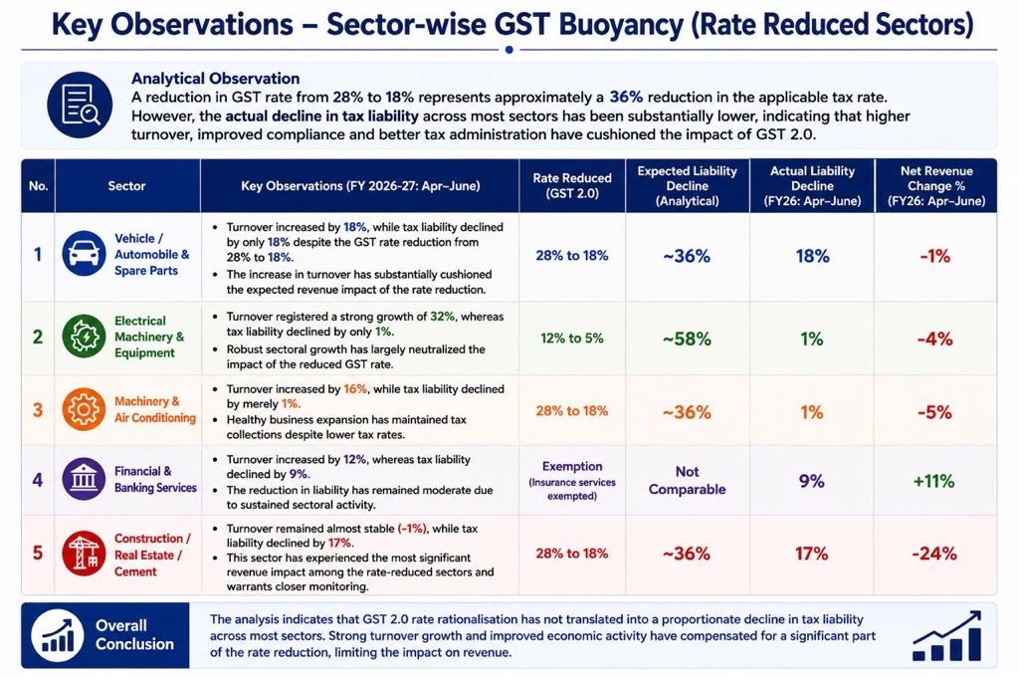
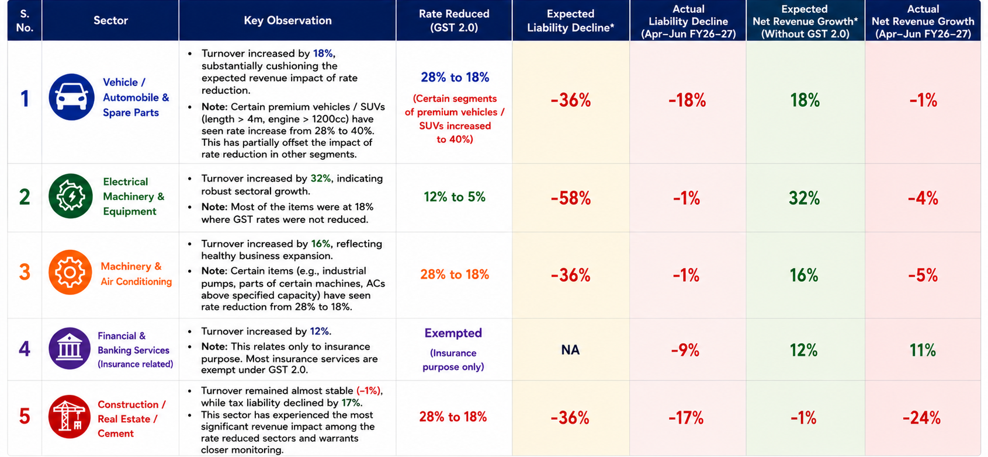

Slide 5

Summary: Q1 FY26-27 GST Performance
Overall Economic Resilience
18%
The April-June period of FY 2026-27 demonstrates resilient economic activity across most major sectors, despite targeted adjustments in the GST 2.0 framework.
Aggregate Growth: Total liability across all sectors increased slightly, driving a solid 4% growth in net revenue to the state.
TURNOVER BUOYANCY
9%
Turnover Expansion: Total turnover climbed from ₹5.18 Lakh Cr in Q1 FY26 to ₹6.17 Lakh Cr in Q1 FY27.
Divergent Outcomes: While overall numbers are highly positive, sectoral performance is highly fragmented depending on whether rates were reduced, unchanged, or increased under GST 2.0.
NET REVENUE GROWTH

Slide 6








Sectoral Impact of GST 2.0 Rate Adjustments
Rate Reduced Sectors
Unchanged Rate Sectors
Rate Increased Sectors
Strong turnover, lower revenue. Sectors like Electrical Machinery saw excellent turnover buoyancy (+32%), indicating volume growth.
Massive revenue capitalization. The Fuel and Energy sector experienced a modest 5% turnover buoyancy.
Robust and uniform growth. Sectors untouched by GST 2.0 changes exhibited strong, stable performance across all metrics.
Despite slower volume growth, the increased rate structure successfully capitalized on the sector, resulting in a dramatic +38% surge in Net Revenue to the State.
However, the reduced rates led to broad declines in Net Revenue to the State, most notably a severe -24% contraction in Construction and Real Estate revenue.
'Articles of iron or steel' led this category with an exceptional 38% turnover buoyancy and a massive +26% growth in net revenue generation.

Slide 7





Best Practices Relating to Compliance Improvement and Tax Administration
2
The State has implemented several technology-enabled initiatives to strengthen compliance monitoring and improve tax administration efficiency through data-driven insights, automated systems and digital compliance solutions.
KEY INITIATIVES
Visibility of taxpayer filing status (via GSTN API)
Provides visibility regarding taxpayer filing status and enables monitoring of filing behaviour along with estimated potential revenue
Dedicated automated dashboard for monitoring GSTR-3B and GSTR-1 return defaulters.
.
Automated analysis and discrepancy detection
Utility assists officers in identifying discrepancies, mismatches and potential revenue leakages through automated comparison and analytical checks.
Risk-based selection and desk review
Enables data-driven audit selection, case allocation and desk review for focused and effective interventions.
Digital and automated scrutiny process
Faceless scrutiny framework ensures risk-based case selection and digital order generation.
Timely reminders and compliance notices
Platform provides automated communication capabilities for timely issuance of reminders and compliance notices to taxpayers
Automated communication of reminders and compliance notices to taxpayers.
.
Government of Rajasthan | GST Revenue Trends 2026–27

Slide 8





















Technology Driven Monitoring System & Enforcement
Integrated analytical ecosystem enabling real time monitoring, intelligent risk assessment and targeted enforcement
Non-Filer Monitoring
ITC Risk & Anomaly Detection
•
Identification of GSTR-3B / GSTR-1 non-filers
•
Detection of abnormal ITC claims & refund patterns
•
Prioritization based on turnover, ITC & risk score
•
Supplier risk analysis & fake invoice identification
Sector & Outlier Analysis
HSN / Commodity Intelligence
•
Sector performance benchmarking
•
Commodity flow tracking & HSN anomaly detection
•
Outlier detection on tax rate, margins & ITC ratio
•
Mapping taxpayers to HSN codes & risk flags
Predictive Revenue Analytics
Feedback & Field Intelligence
•
Revenue estimation from high-risk segments
•
Captures field intelligence & case outcomes
•
Prioritization of high-value enforcement cases
•
Continuous improvement of risk models
Facial Image Cross-verification at Registration
Behavioral & Transaction Pattern Analysis
Automated Risk Scoring of Taxpayers
AI/ML Fake Taxpayer Detection Engine
Circular Trading & Fake Invoicing Network Detection
OCR-based Verification of Documents (Bills, Agreements & More)
AI/ML based scoring to prioritize high-risk taxpayers.
Comprehensive Fraud Detection Capabilities
Identifies fake taxpayers using ITC flow & network analysis.
Verifies identity authenticity using facial recognition.
Detects unusual patterns in transactions and business behaviour.
Detects circular trading networks and fake invoicing patterns.
Automated OCR verification of supporting documents to detect anomalies and mismatches.

Slide 9

















Technology Driven Monitoring System & Enforcement
Integrated analytical ecosystem enabling real time monitoring, intelligent risk assessment and targeted enforcement
Early Detection of Fraud
Advanced analytics and AI/ML models enable proactive identification of high-risk taxpayers and suspicious transactions.
E-Way Bill ✅
VAHAN 💾
Mining Department 💾
Electricity Department ✅
Prevention of Revenue Leakage
Timely interventions and risk-based actions help prevent tax evasion and minimize revenue leakages.
RERA 💾
IFMS
Income Tax
NPCI
Faster Investigations
Integrated data and intelligent tools reduce investigation time and improve case quality and outcomes.
JDA
UHD
RGHS 💾
Stronger Collaboration
IGRS ✅
Seamless intelligence sharing with field officers and departments enhances coordination and effectiveness.
✅ API integration done
💾 – Data Dump received
Higher Revenue Realization
Unified data ecosystem enables comprehensive taxpayer profiling, cross-verification and intelligence-led enforcement.
Data-driven enforcement and focused interventions lead to improved compliance and higher voluntary adherence.
Government of Rajasthan | GST Revenue Trends 2026–27

Slide 10
Technology Driven Monitoring, Fraud Detection & Intelligence Sharing
Technology Driven Monitoring System & Enforcement
Integrated analytical ecosystem enabling real time monitoring, intelligent risk assessment and targeted enforcement
Particulars | Completed in FY 2025-26 | Upto May’26 | June’26 | Overall Progress in FY 2026-27
No. of Cases | 638 | 98 | 123 | 221
No. of Arrests | 6 | 2 | 0 | 2
No. of Vehicle Inspection | 267 | 12 | 29 | 41
Revenue Realized | 459 Cr. | 107.61 Cr. | 77.77 Cr. | 185.38 Cr.
Month | Additional Revenue via Intelligence Reports
 | FY 2026-27
April | 119.72 Cr.
May | 273.20 Cr.
June | 232.28 Cr.

Slide 11
Fraud Detection Frameworks & Intelligence Sharing
Particulars | FY 2025-26 | FY 2026-27
Fake Firms Detected | 330+ | 52
ITC Involved | 668.41 | 226.27
Suspicious Firms (Repeat offenders) | - | 2675
Suspicious Firms – Registration Cancelled (Improper Documents and field visit) | - | 3752

Slide 12











Sector Outlier Detection Dashboard
Identify high-risk taxpayers within each sector using sector-level benchmarking and drill-down analytics.
Selecting any sector automatically displays the list of taxpayers belonging to that sector, highlighting GSTINs exhibiting abnormal behaviour based on predefined sectoral benchmarks.
ITC Ratio
Interstate Supply Ratio
Revenue-to-Liability Ratio
Compare taxpayer ITC ratio with sector average.
Identify taxpayers with unusually high interstate supplies.
Highlight taxpayers requiring verification based on revenue patterns.
1. SECTOR SUMMARY (FY26)
2. TAXPAYER DRILL-DOWN (Accommodation, food and beverage services)
Normal
Moderate Outlier
High Outlier
Sector | Sector ITC % | Ratio of interstate liability | Revenue to Liability % | No. of Taxpayers
VEHICLE/AUTOMOBILE & SPARE PARTS | 91.18% | 40.47% | 42970.14 | 2460
MACHINERY & AIR CONDITIONING | 89.71% | 52.15% | 60070.69 | 4603
FUEL AND ENERGY | 78.63% | 25.38% | 55391.78 | 838
ELECTRICAL MACHINERY AND EQUIPMENT | 93.44% | 40.18% | 46739.84 | 4892
IRON AND STEEL | 94.89% | 27.72% | 27627.05 | 3422
GSTIN | Trade Name | Total | Total | Total | Net | ITC | Interstate | Rev to | Zone / Circle / Ward | Total GTO / | Interstate Supply
 |  | Cash | ITC | Liability | Revenue | Ratio % | Supply % | Liability %
08AABCD4946L1ZA | ETERNAL LIMITED | 9 | 1,033 | 10,533 | 5,178 | 9.81 | 1.14 | 49.16 | Circle-D Jaipur II / Ward 8 | 3441.97 | 120.38
08AACFJ2707D1ZU | SWIGGY | 4 | 2,380 | 6,424 | 2,511 | 37.04 | 0.01 | 39.09 | Circle-C Jaipur II / Ward 11 | 2359.70 | 0.59
08AAKCM07S3E1Z1 | KEYSTONE RESORTS | 2 | 3,807 | 5,449 | 1,630 | 69.86 | 0.35 | 29.92 | Circle-A Udaipur / Ward 7 | 3304.71 | 1.93
08AAACH4899R1Z6 | RAMEAGH PALACE | 3 | 2,127 | 4,829 | 1,785 | 44.04 | 1.34 | 36.97 | Circle-I Jaipur II / Ward 21 | 2976.83 | 6.47
08AACCJ1676Z4WZ | TRITON HOTELS AN. | 3 | 1,172 | 3,831 | 1,695 | 30.58 | 1.68 | 42.45 | Circle-J Jaipur II / Ward 5 | 2395.29 | 6.41
08AACCK3145P1Z6 | Tulsi Palace Resorts | 1 | 1,150 | 3,869 | 1,702 | 38.61 | 0 | 46.18 | Circle-J Jaipur II / Ward 9 | 3213.68 | 5.79
08AAGCS2560J1Z6 | SERVEALL LAND PVT | 2 | 1,815 | 2,930 | 1,040 | 38.06 | 11.08 | 35.61 | Circle-D Jaipur I / Ward 16 | 1824.50 | 324.86
08AAACCF6489R1ZW | THE OBEROI UDAIVIL. | 2 | 1,808 | 2,828 | 1,348 | 35.65 | 0 | 47.66 | Circle-D Udaipur / Ward 12 | 1708.46 | 57.06
08AAACT3875G1Z7 | THE INDIAN HOTELS.. | 1 | 1,704 | 2,652 | 895 | 45.41 | 1.6 | 33.74 | Circle-D Udaipur / Ward 19 | 1625.32 | 42.34
Top 5 sectors contribute 45% of total Net Revenue to State in FY26.
Normal
Moderate Outlier
High Outlier
Within acceptable
benchmark range
Deviates moderately
from sector benchmark
Significantly deviates
from sector benchmark
Outliers are identified based on deviation from sector average benchmarks for ITC Ratio, Interstate Supply Ratio and Revenue-to-Liability Ratio.
1. Sector Selected
2. Sector Benchmark Calculated
3. Taxpayer Comparison
4. Outlier GSTIN Highlighted
5. Officer Verification
Officer selects a sector from the sector list.
System calculates average benchmarks for the sector.
All taxpayers in the sector are compared against benchmarks.
High-risk taxpayers are flagged for review.
Field officers verify and take appropriate action.

Slide 13
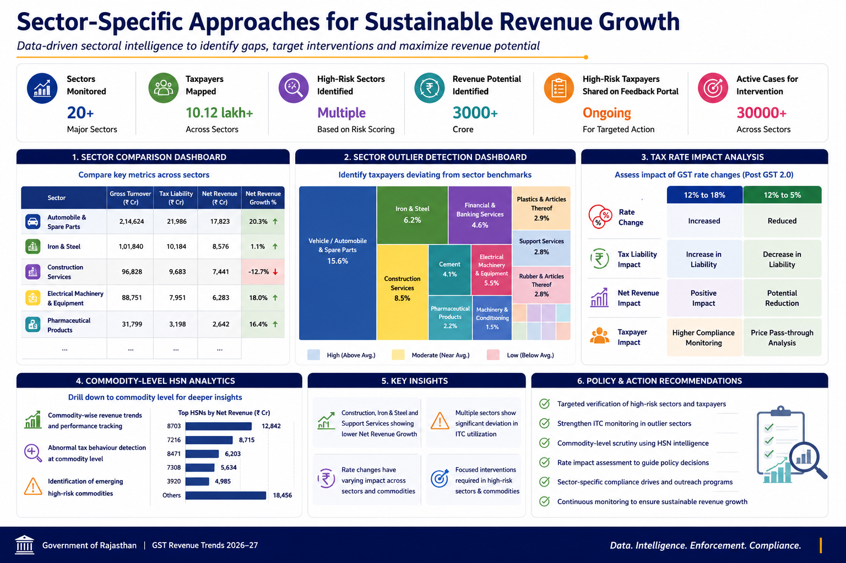
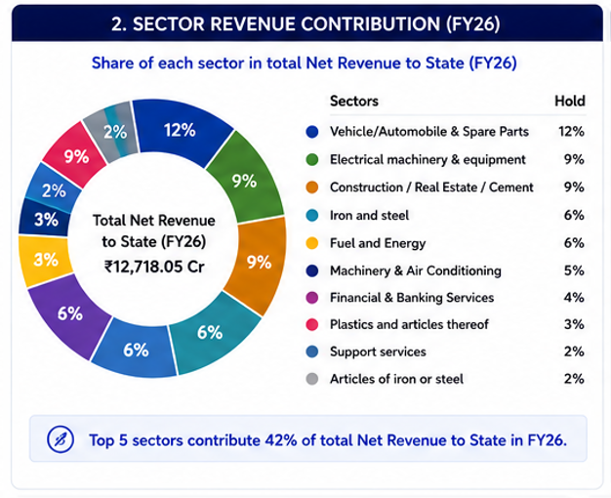
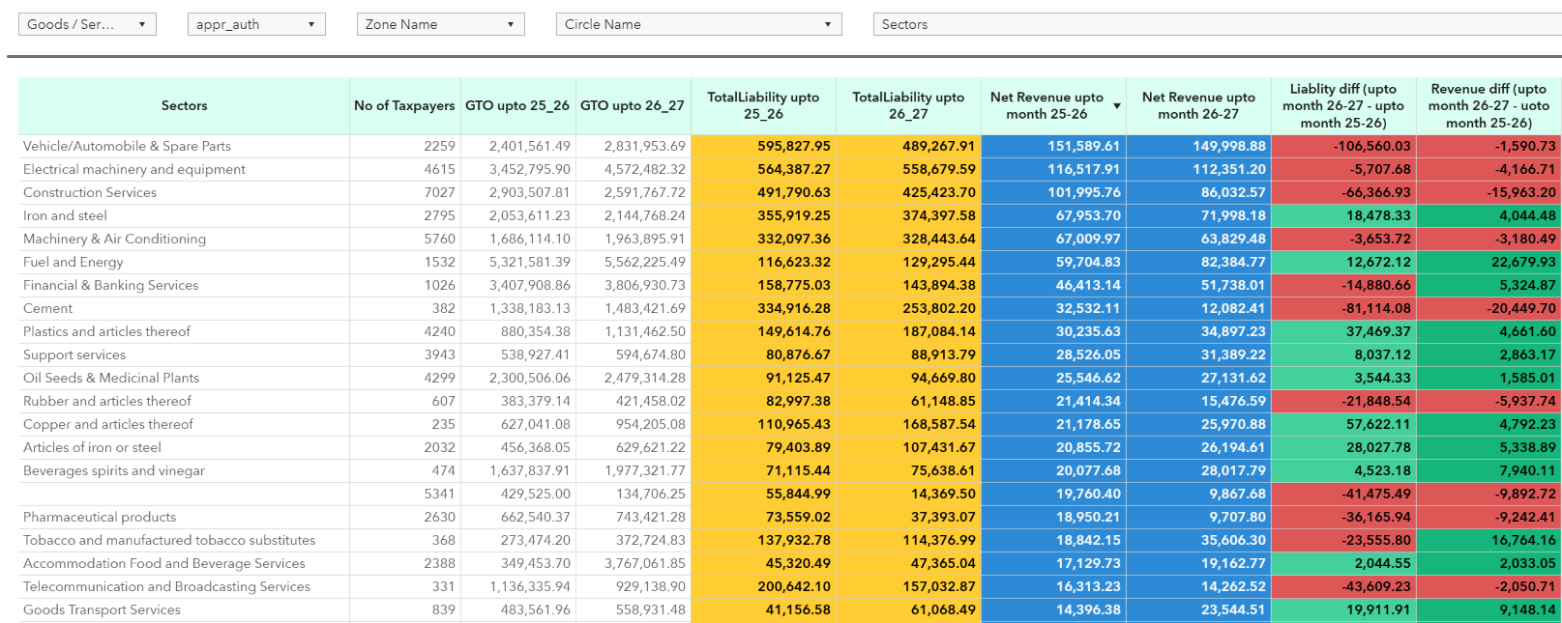
Sector Specific Approaches for revenue

Slide 14
Policy and Administrative Reforms

Slide 15
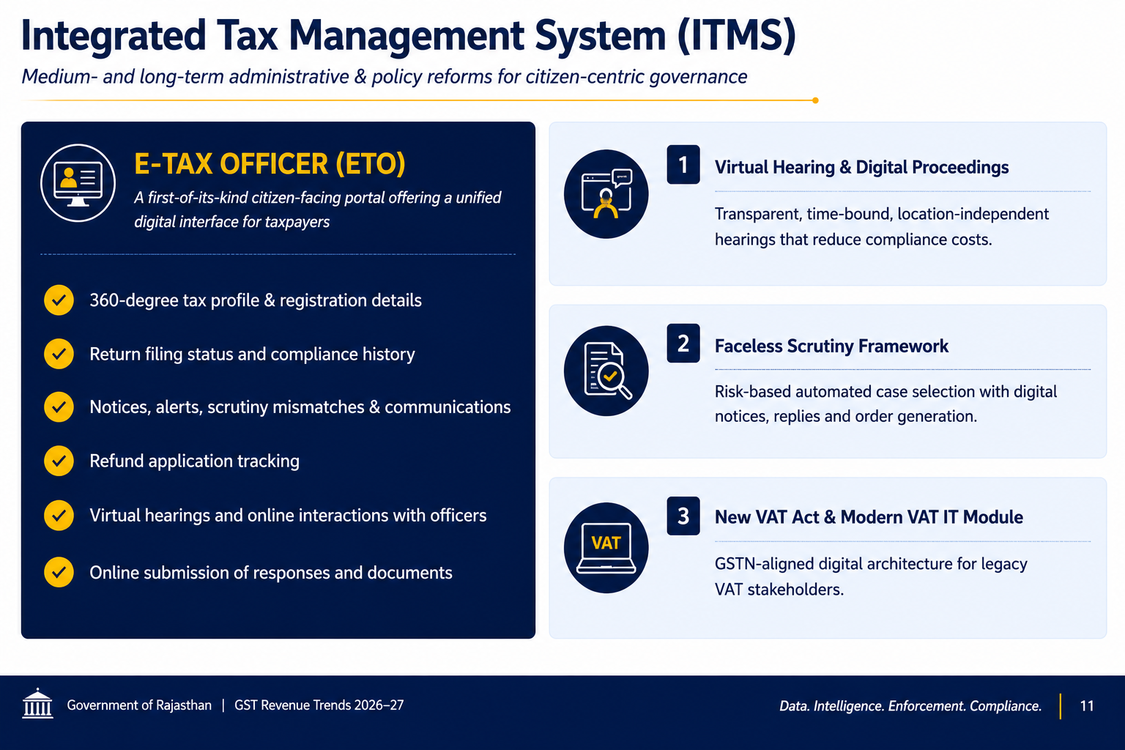

Slide 16
#1 Organizational strengthening
Re-align Rajasthan Commercial Taxes Service to the current GST workload — end the VAT-era pyramid.
How
Operational levers
RCTS Cadre review with dedicated verticals: Refund & ITC scrutiny, Big-Taxpayer Unit, Data Analytics Cell
Fill vacancies at ACCT / CTO levels, timely DPCs and postings.
Top-500 GSTIN State Big-Taxpayer Unit with continuity of officer engagement
Creation and Strengthening of revision cell for the exercise of revisional authority of chief commissioner u/s section 108 of CGST ACT. This will help examine records of decisions passed by proper officers and if required modify annul or enhanced demands in these orders. For this proposal is already submitted with Finance Dept.
Top Taxpayers | % share in Revenue
Top 500 | 48.37%
Top1000 | 58.13%
Top 5000 | 77.14%
Top 10000 | 83.89%
Top 25000 | 91.79%
Top 1 Lakh | 98.70%
E x p e c t e d o u t c o m e
Better monitoring of field officers.
Enhanced effectiveness by rationalizing of the workload.

Slide 17
#2 Housekeeping — Clean Databases & Pendency Disposal
Get the foundational data clean so analytics can actually work.
How
Operational levers
Suo-moto cancellation of GSTINs for persistent non-filers.
Verification of taxpayers with suspicious e-Way Bill transactions.
Physical verification of new registrations with high inter-State sales and ITC claims.
27896 pending SCNs as on 1st May 2026 to be adjudicated/disposed on priority.
State-wide pendency dashboard (assessments, refunds, appeals) tracked bi-weekly.
GSTIN PAN<>Aadhaar<>bank reconciliation; flag duplicate/clone GSTINs at the same address
Total 2582 taxpayers are repeated offenders who have more than 10 notices in last 3FY.
Time frame | Pending Cases 1st May 2026
Less than 1 Month | 3903
1-3 Months | 2800
More than 3 Months | 21193
Total | 27896
E x p e c t e d o u t c o m e
Pendency < 50% of inventory in 12 months; a cleaner base directly reduces the B2C-ratio reading.
Addresses following diagnostic points
B2C Ratio Anomaly
Peer band and cash anomaly

Slide 18
#3 AI Tools for Monitoring, Audit, Enforcement & Scrutiny
Industrialize AI/ML against the exact anomalies the diagnostic flags.
.
How
Operational levers
Data Request from CBIC/GSTN to understand the methodology behind the peer band distribution.
Once the list of 5.37 L taxpayers is received, Data Analysis on these taxpayers will be conducted at the state level to issue ASMT-10 wherever required.
Graph-network analysis on GSTR-1 and e-way bill for the identified taxpayers
AI / ML use cases to detect tax evasion and fake taxpayers.
Turnover vs cash | Zero Cash | 0 to 10K | 10k to 25K | 5K to 50K | 50K to 1L | 1L to 5L | 5L to 10L | 10L to 20L | 20L to 50L | 50L to 1Cr | 1Cr to 2.5Cr | 2.5Cr to 5Cr | above 5Cr | Grand Total
Above 500Cr | 5 | 5 | 2 | 1 | 9 | 24 | 16 | 33 | 49 | 37 | 59 | 49 | 307 | 596
100Cr to 500Cr | 126 | 56 | 29 | 43 | 64 | 278 | 191 | 225 | 346 | 249 | 349 | 261 | 430 | 2,647
50Cr to 100Cr | 317 | 129 | 74 | 96 | 129 | 541 | 343 | 354 | 455 | 377 | 450 | 227 | 155 | 3,647
25Cr to 50Cr | 1033 | 367 | 199 | 236 | 340 | 1493 | 815 | 746 | 876 | 668 | 667 | 254 | 57 | 7,751
10Cr to 25Cr | 3990 | 1233 | 757 | 930 | 1299 | 4819 | 2151 | 2072 | 2814 | 1483 | 884 | 118 | 6 | 22,556
5Cr to 10Cr | 5249 | 2182 | 1407 | 1717 | 2474 | 6948 | 2898 | 3151 | 3157 | 1002 | 396 | 1 | 2 | 30,584
2.5Cr to 5Cr | 9282 | 5476 | 3263 | 3381 | 4037 | 10623 | 4853 | 4254 | 2724 | 775 | 4 | 1 | 3 | 48,676
1Cr to 2.5Cr | 23939 | 14405 | 6409 | 6319 | 7499 | 19574 | 7893 | 4862 | 2960 | 7 | 8 | 1 | 0 | 93,876
40L to 1 Cr | 41601 | 20571 | 7864 | 7433 | 8779 | 22474 | 7831 | 3763 | 2 | 3 | 2 | 0 | 1 | 1,20,324
20L to 40 L | 34180 | 15036 | 5587 | 4974 | 6079 | 15777 | 3129 | 2 | 3 | 0 | 0 | 0 | 0 | 84,767
0 to 20 L | 117655 | 55145 | 15610 | 12477 | 11649 | 12919 | 9 | 6 | 1 | 0 | 0 | 1 | 2 | 2,25,474
Zero Turnover | 251959 | 429 | 48 | 30 | 14 | 18 | 9 | 5 | 2 | 0 | 0 | 0 | 0 | 2,52,514
Grand Total | 4,89,336 | 1,15,034 | 41,249 | 37,637 | 42,372 | 95,488 | 30,138 | 19,473 | 13,389 | 4,601 | 2,819 | 913 | 963 | 8,93,412

Slide 19
#4 Informers & Government-Servant Reward Scheme
Operationalize the existing but dormant reward scheme — generate field intelligence.
H o w
Operational levers
SOP at the department level is ready and will be issued this month. For operationalizing the existing finance department scheme in CTD.
For this, a token amount of 1 Rs. is allotted in the budget and proposal for the budget will be sent.
Sensitize Police, Transport, Mining, Excise, RIICO field staff, and citizens to the scheme.
An Informant Management System, ‘Sutra Dhaar’, will be created on the ITMS portal with automatic anonymization, secure case routing to the concerned Enforcement Wing, and escrow-style reward mapping under the Reward Scheme, 2021.
Strengthen Human Intelligence Reports : Leverage field intelligence, market surveys, enforcement inputs, and local trade information to validate analytical findings and identify sectors exhibiting abnormal B2C patterns.
Addresses following diagnostic points
Eway bill to revenue
B2C Ratio anomaly
E x p e c t e d o u t c o m e
Field intelligence pipeline restarted; catalyses cases data alone misses (cash- leg evasion, parallel invoicing).

Slide 20
#5 Expedite Legal cases disposal
Convert audit and enforcement detections into actual realization through a strong, motivated legal team.
H o w
Operational levers
Urgent approval of the pending Panel Lawyers proposal for High Court, commercial courts and NCLT — engage a team of professional GST-specialist counsels.
Appointment of panel lawyers at GSTAT;
Strengthen the Appellate Authority bench-strength and infrastructure through cadre reorganization
Departmental SOP — every significant audit/enforcement case to be monitored at HQ level; publish win-rate KPIs; CPE (Continuing Professional Education) training in GST jurisprudence
Total Pending appeals as on date is 13913 and amount involved 3206.76 crores.
Addresses following diagnostic points
Growth Lag
B2C Ratio anomaly
Peer band and cash anomaly
E x p e c t e d o u t c o m e
GSTAT has just become operational — every favorable ruling creates a long-term, recurring revenue impact. Stronger representation directly raises realization from already-detected audit, enforcement and fake-ITC cases (the largest stock of unrealized demand on the books).

Slide 21
#6 Data-Driven Enforcement & Special Drives
1. Sector-Based Enforcement: Identify sectors exhibiting abnormal B2C ratios, revenue growth lag, and GST-to-GSDP gaps. Focus : Automobile and spare parts, Electrical machinery, Finance and banking, construction, Iron steel, Support services.
2. Analytics-Based Taxpayer Selection : Identify sector-specific outliers through B2C ratio analysis. Detect taxpayers showing : B2C Ratio analysis, Peer band comparison, Cash Payment anomalies, Revenue growth deviations, E-way bill vs Revenue mismatch
3. Theme-Based Special Drives :
Area Specific campaigns: Kishangarh Makrana marble belt, Major commercial hubs
Focused campaigns in high-risk sectors : Marble & Stone, Tobacco Products, Timber & Plywood, Hotels & Tourism, Restaurants & Banquets, Jewelry & Textile Trade 4. Intelligence & Inter-Agency Coordination
• Strengthen Human Intelligence inputs
• Market surveys and field verification
• Coordination with CBIC/ DGCI for interstate fraud networks.
• Aadhaar e-KYC verification for high risk taxpayers
Addresses following diagnostic points
• B2C Ratio Anomaly
• Peer Band Deviation
• Cash Payment Anomaly
• Revenue vs GSDP Gap
• e-Way Bill vs Revenue Mismatch
Expected Outcome
• Identification of sectoral outliers
• Improved detection of suppression and fake invoicing.
• Stronger intelligence-led enforcement
• Improved compliance

Slide 22
#7 Enforcement Wing Strengthening — Fake ITC / Layer Cracking
Build muscle to dismantle fake-invoicing layers (proposal already submitted).
H o w
Operational levers
Forensic Accounting, Cyber Investigation & Prosecution Cells : In-house wing equipped to extract and examine seized digital devices (mobile phones, laptops, Tally backups, and hard drives) and to forensically analyze kacchi parchis and other informal records, while maintaining a chain of custody compliant with Section 63 of the (BSA), 2023.
Digital Search & Seizure Toolkit : Technology-enabled investigation framework for digital evidence collection, data extraction, document analysis, and forensic examination during search and seizure operations.
Proposal Submitted to Finance Department : Proposal for establishment of specialized investigation capabilities and deployment of digital enforcement tools has already been submitted for approval.
Addresses following diagnostic points
B2C Ratio anomaly
Peer band and cash anomaly
E x p e c t e d o u t c o m e
Visible arrests / prosecutions break the low-risk-high-reward perception.

Slide 23
CS meeting with Secretary Revenue
Point 1 : The note mentions that Rajasthan's B2C ratio is approximately 7, against a normal benchmark ratio of 4.5.
To verify this observation, detailed data was requested from GSTN regarding Domestic Supply and B2C Supply reported in GSTR-1 for Rajasthan as well as for All India.
All India Financial Year wise Domestic supply and B2C supply declared in GST-R1
Financial year | B2C Supply (in Cr.) | Domestic Supply (in Cr.) | %age of B2c
2017-2018 | 32,03,149.70 | 1,68,31,561.66 | 19.03%
2018-2019 | 48,64,369.10 | 2,60,84,624.77 | 18.65%
2019-2020 | 49,56,674.65 | 2,61,51,869.40 | 18.95%
2020-2021 | 46,76,537.97 | 2,61,05,687.42 | 17.91%
2021-2022 | 58,34,371.10 | 3,44,32,704.92 | 16.94%
2022-2023 | 69,44,319.61 | 4,07,16,149.24 | 17.06%
2023-2024 | 76,38,258.07 | 4,44,21,758.61 | 17.19%
2024-2025 | 82,65,464.89 | 4,95,14,287.09 | 16.69%
2025-2026 | 91,56,046.95 | 5,67,43,999.87 | 16.14%
Grand Total | 5,55,39,192.04 | 32,10,02,642.96 | 17.30%
Rajasthan Financial Year wise Domestic supply and B2C supply declared in GST-R1
Financial year | B2C Supply (in Cr.) | Domestic Supply (in Cr.) | %age of B2c
2017-2018 | 1,30,026.52 | 6,84,188.69 | 19.00%
2018-2019 | 1,95,779.32 | 10,53,037.60 | 18.59%
2019-2020 | 2,00,408.75 | 10,52,293.59 | 19.04%
2020-2021 | 1,97,259.29 | 10,86,096.29 | 18.16%
2021-2022 | 2,50,554.61 | 14,41,519.98 | 17.38%
2022-2023 | 2,94,465.25 | 16,83,652.64 | 17.49%
2023-2024 | 3,22,295.26 | 18,10,576.38 | 17.80%
2024-2025 | 3,47,704.04 | 19,95,807.53 | 17.42%
2025-2026 | 3,84,975.90 | 22,50,953.39 | 17.10%
Grand Total | 23,23,468.94 | 1,30,58,126.10 | 17.79%
Conclusion : Based on the data provided by GSTN, no significant difference is observed in the proportion of B2C supplies reported by Rajasthan when compared with the All India trend.

Slide 24
CS meeting with Secretary Revenue
Point 2 : The note further mentions that an anomaly detection technique identified approximately 5.37 lakh taxpayers who paid lower tax compared to their respective peer band. It also states that, out of these, approximately 1.22 lakh taxpayers paid only ₹194 crore through the cash ledger.
To facilitate detailed examination and appropriate enforcement action, the following information was requested from GSTN:
a) Detailed methodology and analytical framework adopted for anomaly detection.
b) Definition and criteria used for determining the "Peer Band".
c) Parameters considered for grouping taxpayers into peer bands, such as turnover, industry, HSN/SAC, geographical location, filing behaviour, compliance profile, or any other relevant criteria.
d) Taxpayer-wise list of the identified 5.37 lakh taxpayers categorized as paying lower tax than their respective peer band.
e) Taxpayer-wise details of the 1.22 lakh taxpayers referred to in the note who reportedly paid only ₹194 crore in cash.
Current Status : As on date, GSTN has not provided any of the above information.

Slide 25




Measures to be Adopted in Next Quarter for Revenue Augmentation
1 / 3
Targeted administrative and technology interventions to enhance compliance, curb leakages and accelerate sustainable GST revenue growth.
1
Improve Return Filing Compliance
2
Concurrent Scrutiny of Returns
3
AI-Based Risk Profiling
4
Sector-Specific Revenue Monitoring
Focused monitoring of Top 1 lakh taxpayers.
Follow-up with high tax-paying GSTR-1 filers.
Ensure timely reversal of ineligible IGST ITC in exempt/non-GST supplies.
Automated compliance reminders and officer-level monitoring.
Expand concurrent scrutiny using risk parameters.
Early identification of mismatches between GSTR-1, GSTR-3B and GSTR-2B.
Prioritise high-revenue impact cases.
Risk profiling using GSTR-1, GSTR-3B, e-Invoice and e-Way Bill data.
Early identification of fake ITC beneficiaries.
Automated risk scoring and prioritisation.
Focus enforcement on sectors with declining tax buoyancy:
Construction / Real Estate / Cement
Vehicle & Automobile
Electrical Machinery & Solar
Machinery & Air Conditioning
Fuel & Energy
Objective: Enhance timely compliance among high-value taxpayers.
Objective: Detect revenue leakages at an early stage.
Objective: Target high-risk taxpayers through analytics.
Objective: Focus enforcement on high-risk, low-buoyancy sectors.
Government of Rajasthan | GST Revenue Trends 2026–27

Slide 26









Measures to be Adopted in Next Quarter for Revenue Augmentation
1 / 3
Targeted administrative and technology interventions to enhance compliance, curb leakages and accelerate sustainable GST revenue growth.
5
Strengthen Data Integration
6
Strengthen Audit & Enforcement
7
Encourage Voluntary Compliance
8
Cleansing of Nil Filers
Banking
Urban Dev. &
Housing (UDH)
RERA
VAHAAN
RERA
Pre-notice communication and taxpayer education.
Compliance ratings for taxpayers.
Facilitation of genuine taxpayers.
Reduce litigation and enhance trust.
Risk-based audit selection.
AI-assisted audit planning.
Target fake invoice networks through supplier–recipient linkage analytics.
Improve RCM compliance.
Monitor abnormal ITC utilization.
Faster disposal of scrutiny and audit cases.
Identify and eliminate non-genuine Nil-filers to curb revenue leakage and maintain a clean taxpayer base.
Flag taxpayers filing Nil returns despite active signals like e-way bills & Prioritize high-turnover-signal Nil-filers for investigation and follow-up action.
Mining
JDA
Electricity
IGRS
Integrated verification with external databases to detect suppression and ensure accuracy.
Cross-verification of taxpayer activities, assets and transactions.
Objective: Improve cross-verification using external databases.
Objective: Improve realization of additional revenue.
Objective: Improve compliance with minimum enforcement.
Objective: Deregister genuinely inactive GSTINs to maintain an accurate taxpayer base
Government of Rajasthan | GST Revenue Trends 2026–27

Slide 27






Measures to be Adopted in Next Quarter for Revenue Augmentation
3 / 3
KEY FOCUS AREAS
Compliance Improvement
Technology-Driven Monitoring
Sector-Specific Enforcement
AI-Based Risk Profiling
Data Integration
Faster Revenue Realization
Timely filing, correct reporting and ITC reversals
Real-time analytics, AI/ML and risk detection
Targeted action on high-risk and low-buoyancy sectors
Early identification of high-risk taxpayers
Stronger linkage with external government and departmental data
Effective audits, enforcement and compliance actions
Government of Rajasthan | GST Revenue Trends 2026–27

Slide 28
THANK YOU !!!

